Slide 1

Methods for Causal Inference in Educational Research
January/February 2022
Isa Steinmann

Slide 2
9 | Regression Discontinuity Designs II Time: 14 February 2022, 12:15-14:00h Main instructor: Isa Steinmann Required reading: Luyten (2006)
10 | Differences-in-Differences Designs I Time: 17 February 2022, 12:15-14:00h Main instructor: Isa Steinmann Required reading: Angrist & Pischke (2015), chapter 5
11 | Differences-in-Differences Designs II Time: 21 February 2022, 12:15-14:00h Main instructor: Isa Steinmann Required reading: Strello, Strietholt, Steinmann, & Siepmann (2021)
12 | Lessons Learned and Closing Time: 23 February 2022, 12:15-14:00h Main instructor: Isa Steinmann Required reading: Rutkowski & Delandshere (2016)
9 | Regression Discontinuity Designs II Time: 14 February 2022, 12:15-14:00h Main instructor: Isa Steinmann Required reading: Luyten (2006)
10 | Differences-in-Differences Designs I Time: 17 February 2022, 12:15-14:00h Main instructor: Isa Steinmann Required reading: Angrist & Pischke (2015), chapter 5
11 | Differences-in-Differences Designs II Time: 21 February 2022, 12:15-14:00h Main instructor: Isa Steinmann Required reading: Strello, Strietholt, Steinmann, & Siepmann (2021)
12 | Lessons Learned and Closing Time: 23 February 2022, 12:15-14:00h Main instructor: Isa Steinmann Required reading: Rutkowski & Delandshere (2016)
9 | Regression Discontinuity Designs II Time: 14 February 2022, 12:15-14:00h Main instructor: Isa Steinmann Required reading: Luyten (2006)
10 | Differences-in-Differences Designs I Time: 17 February 2022, 12:15-14:00h Main instructor: Isa Steinmann Required reading: Angrist & Pischke (2015), chapter 5
11 | Differences-in-Differences Designs II Time: 21 February 2022, 12:15-14:00h Main instructor: Isa Steinmann Required reading: Strello, Strietholt, Steinmann, & Siepmann (2021)
12 | Lessons Learned and Closing Time: 23 February 2022, 12:15-14:00h Main instructor: Isa Steinmann Required reading: Rutkowski & Delandshere (2016)

Slide 3
Take-away messages
!
DD can be applied to cross-sectional, country-level data, but analyses should be replicated across all cycles
Achilles' heel of studies with only two measurement points is common trends assumption, since it cannot be empirically substantiated

Slide 4
Overview
Causal inference quiz
Assignment requirements
Feedback

Slide 5
Causal inference quiz: Rubin’s potential outcome framework
1
What do ceteris paribus and selection bias mean?

Slide 6
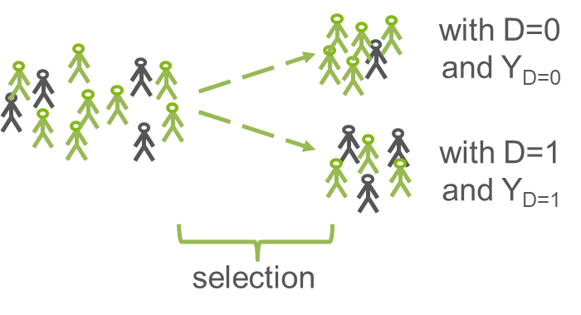


Causal inference quiz: Rubin’s potential outcome framework
1
What do ceteris paribus and selection bias mean?
?

Slide 7
Causal inference quiz: Rubin’s potential outcome framework
2
What is the hypothetical, ideal experiment?

Slide 8
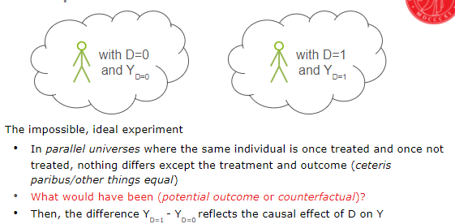
Causal inference quiz: Rubin’s potential outcome framework
2
What is the hypothetical, ideal experiment?

Slide 9
Causal inference quiz: Rubin’s potential outcome framework
3
Why is correlation ≠ causation?

Slide 10
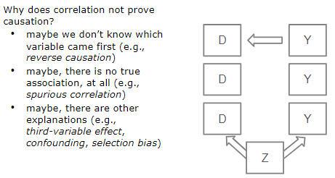
Causal inference quiz: Rubin’s potential outcome framework
3
Why is correlation ≠ causation?

Slide 11
Causal inference quiz: Rubin’s potential outcome framework
4
When is causal inference possible?

Slide 12
Causal inference quiz: Rubin’s potential outcome framework
4
When is causal inference possible?
plausible causal mechanism
treatment before outcome
comparison with counterfactual
ceteris paribus

Slide 13
Causal inference quiz: (Quasi-)experiments
5
What are core features of randomized controlled trials?

Slide 14
Causal inference quiz: (Quasi-)experiments
5
What are core features of randomized controlled trials?
Treatment and control condition that are manipulable by researchers
Randomized allocation to treatment and control condition
Outcome comparison between treatment and control group
Balance checks (ceteris paribus)

Slide 15
Causal inference quiz: (Quasi-)experiments
6
What are core features of quasi-experiments?

Slide 16
Causal inference quiz: (Quasi-)experiments
6
What are core features of quasi-experiments?
Treatment and control condition that are manipulable, but not necessarily by researchers
Non-random allocation to treatment and control condition (e.g., self-selection, administrator selection)
Outcome comparison between treatment and control group
Selection bias in outcome comparison is circumvented

Slide 17
Causal inference quiz: (Quasi-)experiments
7
What are examples for non-causal research questions?

Slide 18
Causal inference quiz: (Quasi-)experiments
7
What are examples for non-causal research questions?
what is the cause of a phenomenon?
why should there be an association between phenomena (i.e., theory-building)?
what is the nature of a phenomenon (i.e., descriptive questions)?
…

Slide 19
Causal inference quiz: (Quasi-)experiments
8
What are central issues in (quasi-)experiments?

Slide 20
Causal inference quiz: (Quasi-)experiments
8
What are central issues in (quasi-)experiments?
Selection bias
Feasibility
Implementation
Generalization/validity

Slide 21
Causal inference quiz: Randomized controlled trials
9
Why does randomization tackle selection bias?

Slide 22

Causal inference quiz: Randomized controlled trials
9
Why does randomization tackle selection bias?
Law of Large Numbers (LLN)
Importance of representative samples
Importance of large enough samples
“Random assignment works not by eliminating individual differences but rather by ensuring that the mix of individuals being compared is the same. Think of this as comparing barrels that that include equal proportions of apples and oranges” (Angrist & Pischke, 2015, p.16)

Slide 23
Causal inference quiz: Randomized controlled trials
10
How can we make sure that randomization worked?

Slide 24
Causal inference quiz: Randomized controlled trials
10
How can we make sure that randomization worked?
Balance checks
comparing treatment and control group characteristics, and
ideally, pre-treatment differences between treatment and control group

Slide 25
Causal inference quiz: Randomized controlled trials
11
What are major threats to the validity of randomized controlled trials?

Slide 26
Causal inference quiz: Randomized controlled trials
11
What are major threats to the validity of randomized controlled trials?
Selection bias if randomization did not work 100% or noncompliance
Generalizability/representativeness/external validity
Attrition and missing data

Slide 27
Causal inference quiz: Randomized controlled trials
12
What are common ethical issues in randomized controlled trials and how can they be addressed?

Slide 28
Causal inference quiz: Randomized controlled trials
12
What are common ethical issues in randomized controlled trials and how can they be addressed?
Withholding a potentially effective treatment to those who need it
Using regression discontinuity design to assign treatment based on need or merit
Using active control condition with effective treatment
Using waiting-list control condition
…

Slide 29
Causal inference quiz: Randomized controlled trials
13
Why can recruitment be difficult in randomized controlled trials?

Slide 30
Causal inference quiz: Randomized controlled trials
13
Why can recruitment be difficult in randomized controlled trials?
Definitions and locations of target populations
Voluntary consent to participate until the end
Lack of participation motivation, especially in control groups
…

Slide 31
Causal inference quiz: Randomized controlled trials
14
How can randomization be conducted?

Slide 32
Causal inference quiz: Randomized controlled trials
14
How can randomization be conducted?
Simple individual randomization
Stratified randomization (randomization within groups)
Combination with matching (assuring balance of key variables)
Adaptive assignment design
…

Slide 33
Causal inference quiz: Regression methods
15
How can regression methods attain ceteris paribus?

Slide 34
Causal inference quiz: Regression methods
15
How can regression methods attain ceteris paribus?
“Regression-based causal inference is predicated on the assumption that when key observed variables have been made equal across treatment and control groups, selection bias from the things we can’t see is also mostly eliminated.” (Angrist & Pischke, 2015, p. 47)

Slide 35
Causal inference quiz: Regression methods
16
How is selection bias called in world of regression?

Slide 36
Causal inference quiz: Regression methods
16
How is selection bias called in world of regression?
Omitted variable bias
→ If control strategy does not capture whole selection mechanism

Slide 37
Causal inference quiz: Regression methods
17
What do we need to utilize regressions for causal inference?

Slide 38
Causal inference quiz: Regression methods
17
What do we need to utilize regressions for causal inference?
knowledge about the selection mechanisms at play
good observed variables (associated with treatment allocation AND outcome) to capture the selection mechanisms
overlaps in characteristics between treatment and control groups
large enough datasets
appropriate regression model

Slide 39
Causal inference quiz: Regression methods
18
What has to be included in regression studies for causal inference?

Slide 40
Causal inference quiz: Regression methods
18
What has to be included in regression studies for causal inference?
Justification of control strategy
Balance checks
Sensitivity analyses
…

Slide 41
Causal inference quiz: Regression methods
19
What is a propensity score?

Slide 42
Causal inference quiz: Regression methods
19
What is a propensity score?
Individual score reflecting the probability to receive a treatment given a set of observed covariates
Similar to control variables, covariates are selected to depict the selection mechanism as well as possible
Which variables can be assumed to relate to allocation to treatment or control group as well as outcome?
Outcome is never included in set of covariates; pre-treatment measure of outcome is usually a very good covariate

Slide 43
Causal inference quiz: Regression methods
20
How is the propensity score used in propensity score matching methods?

Slide 44
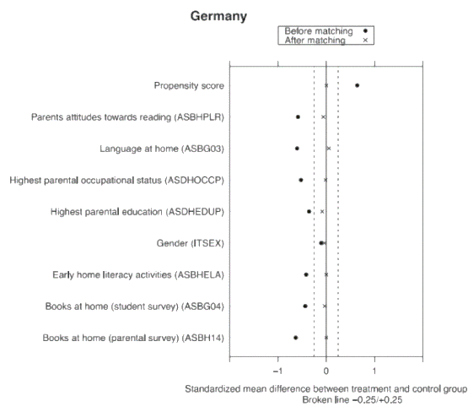
Causal inference quiz: Regression methods
20
How is the propensity score used in propensity score matching methods?
Balancing treatment and control group a posteriori (i.e., make them as comparable as possible given set of covariates)
In 1:1 nearest neighbor matching, we pick the control unit with most similar propensity score for every treatment unit (and exclude remaining control units)
Balance checks assure that groups are similar enough

Slide 45
Causal inference quiz: Regression methods
21
What are advantages of propensity score matching?

Slide 46
Causal inference quiz: Regression methods
21
What are advantages of propensity score matching?
Non-parametric preprocessing of estimation makes estimates more robust to small changes in parametric specification
Separation of estimation procedure in two steps simulates research design of experiment, where outcome is not known at group allocation
Makes areas visible where treatment and control group do not overlap sufficiently in covariates (e.g., Slovakia example)
Matching methods have straightforward diagnostics
Selection mechanisms are explicitly discussed

Slide 47
Causal inference quiz: Regression methods
22
Why are pretest measures of the outcome usually good control variables?

Slide 48
Causal inference quiz: Regression methods
22
Why are pretest measures of the outcome usually good control variables?
Good proxies for selection mechanisms (correlated with group allocation AND outcome)

Slide 49
Causal inference quiz: Regression methods
23
Why can fixed-effect models help cover selection mechanisms?

Slide 50
Causal inference quiz: Regression methods
23
Why can fixed-effect models help cover selection mechanisms?
Controlling for any differences beyond the fixed term (e.g., school-fixed effects control for any differences on school and higher levels)

Slide 51
Causal inference quiz: Regression methods
24
Can we conclude that regression methods can be used for causal inference, especially if they include propensity score matching methods, pretest data, or fixed-effects?

Slide 52
Causal inference quiz: Regression methods
24
Can we conclude that regression methods can be used for causal inference, especially if they include propensity score matching methods, pretest data, or fixed-effects?
Not per se, no. Risk of omitted variable bias usually remains
One can however speculate about the size and direction of omitted variable bias (i.e., OVB formula)

Slide 53
Causal inference quiz: Instrumental variables
25
What is a theoretical, perfect instrumental variable?

Slide 54
Causal inference quiz: Instrumental variables
25
What is a theoretical, perfect instrumental variable?
A variable that determines the treatment status (first stage causal effect) by chance/randomly/like a lottery (independence assumption)
Can be naturally occurring, based on laws or regulations, or introduced by researchers
Only way that instrument affects outcome is through treatment (exclusion restriction)
Full compliance with instrumental variable (i.e., no one treated who was allocated to control group and vice versa)

Slide 55
Causal inference quiz: Instrumental variables
26
What are instrumental variables in reality, usually?

Slide 56
Causal inference quiz: Instrumental variables
26
What are instrumental variables in reality, usually?
A variable that affects the probability of the treatment status by chance/randomly/like a lottery
Can be naturally occurring, based on laws or regulations, or introduced by researchers
Instrumental variable makes participation only more likely for those who should receive the treatment and less likely for those who should not receive the treatment
Non-compliers in both treatment and control condition (always-takers and never-takers)

Slide 57
Causal inference quiz: Instrumental variables
27
How does the instrumental variable approach identify the causal effects of interest?

Slide 58
Causal inference quiz: Instrumental variables
27
How does the instrumental variable approach identify the causal effects of interest?
Two-stage-least-squares (2SLS) estimation decomposes effect of lottery win on outcome and on treatment
Local Average Treatment Effect (LATE) is causal effect of treatment for those whose treatment was solely determined by the instrument
If there are no non-compliers, LATE equals Total Treatment Effect on the Treated (TOT)

Slide 59
Causal inference quiz: Instrumental variables
28
What are central issues in instrumental variable approaches?

Slide 60
Causal inference quiz: Instrumental variables
28
What are central issues in instrumental variable approaches?
Good instruments are rare
External validity of LATEs should be well argued for, especially if instruments are “naturally occurring”

Slide 61
Causal inference quiz: Regression discontinuity designs
29
What is a cut-off in regression discontinuity framework?

Slide 62
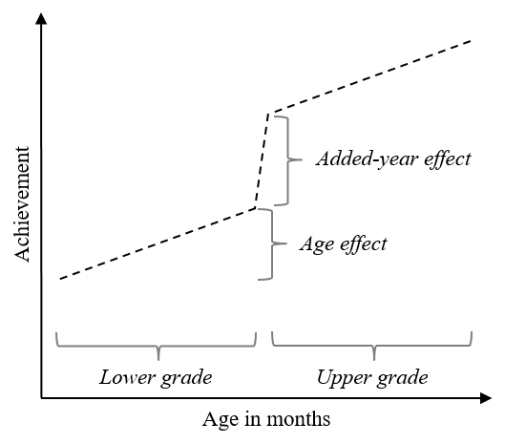
Causal inference quiz: Regression discontinuity designs
29
What is a cut-off in regression discontinuity framework?
Running/forcing variable with fixed cut-off/threshold value
Cut-off determined by rules, laws, regulations, or researchers
Cut-off cannot be manipulated by treatment or control units

Slide 63
Causal inference quiz: Regression discontinuity designs
30
What is the difference between sharp and fuzzy regression discontinuity?

Slide 64
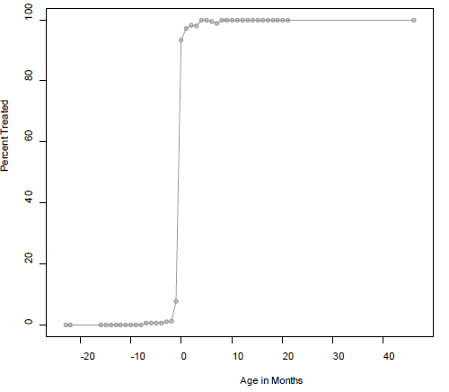
Causal inference quiz: Regression discontinuity designs
30
What is the difference between sharp and fuzzy regression discontinuity?
Sharp: Cut-off in running variable determines treatment status
Fuzzy: Cut-off in running variable affects dose or likelihood of treatment
Fuzzy regression discontinuity is methodologically equivalent to instrumental variable approach

Slide 65
Causal inference quiz: Regression discontinuity designs
31
When can regression discontinuity be interpreted as causal effect?

Slide 66
Causal inference quiz: Regression discontinuity designs
31
When can regression discontinuity be interpreted as causal effect?
If around the cut-off, one can assume that treatment and control units differ in nothing else (including no other treatments)
Comparison of outcomes of control and treatment units around the cut-off can be interpreted as the effect of the treatment
If regression discontinuity prerequisites are checked

Slide 67
Causal inference quiz: Differences-in-differences
32
What is the common trends assumption in differences-in-differences designs?

Slide 68
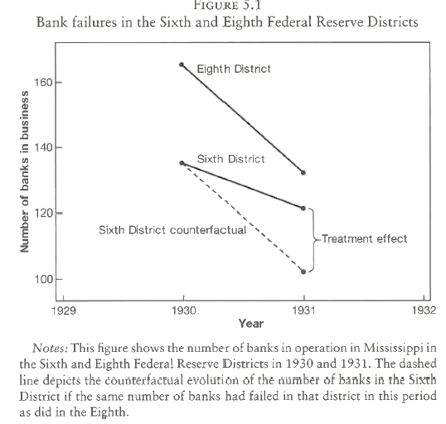
Causal inference quiz: Differences-in-differences
32
What is the common trends assumption in differences-in-differences designs?
Common trends in absence of treatment (i.e., two groups develop similarly unless one gets treated and the other doesn’t)
Levels in outcomes can differ between the groups, though

Slide 69
Causal inference quiz: Differences-in-differences
33
How can differences-in-differences methods identify causal effects?

Slide 70
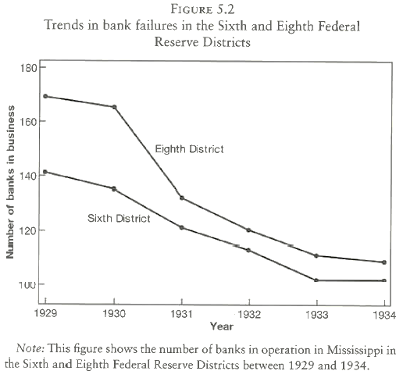
Causal inference quiz: Differences-in-differences
33
How can differences-in-differences methods identify causal effects?
If common trends assumption is theoretically and, if possible, empirically justified, ceteris paribus can be assumed
Difference in trends between treated and control group (differences-in-differences) can be interpreted as causal effect of treatment

Slide 71
Causal inference quiz: Differences-in-differences
34
What are central challenges in differences-in-differences methods?

Slide 72
Causal inference quiz: Differences-in-differences
34
What are central challenges in differences-in-differences methods?
Having enough background information and trend data to justify common trends assumption (especially difficult in case of only two measurement points)
Any further reasons for deviating paths have to be thoroughly discussed
Small sample sizes
Generalizability

Slide 73
?
What do you think? Any questions?

Slide 74
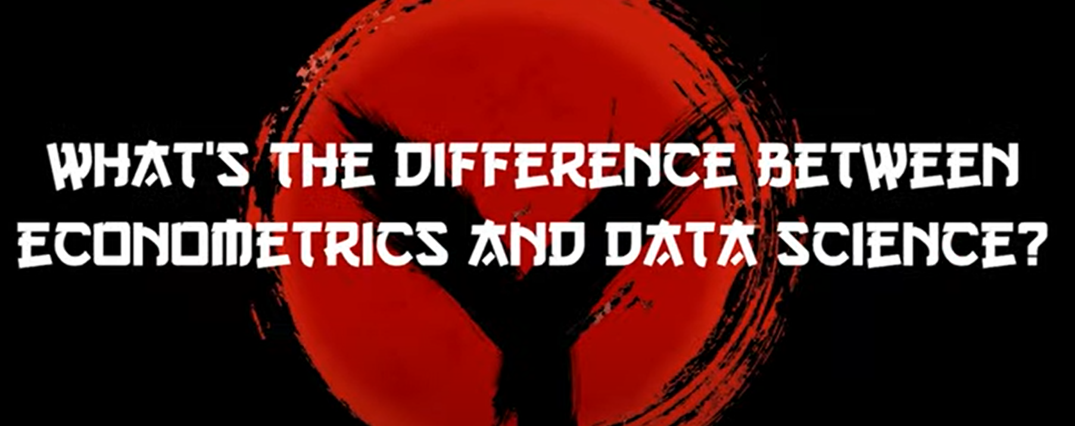
…And because you asked
https://mru.org/courses/mastering-econometrics/whats-difference-between-econometrics-and-data-science

Slide 75

…And because you asked
https://mru.org/courses/mastering-econometrics/whats-difference-between-econometrics-and-statistics

Slide 76
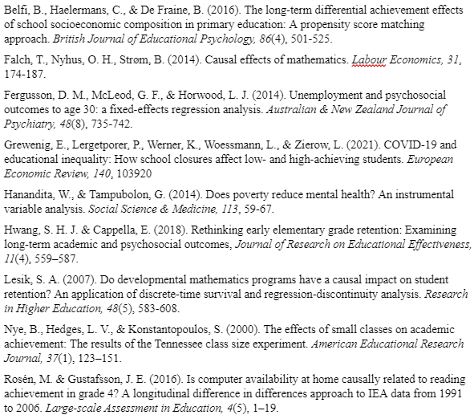
Assignment requirements
Written assignment has to be submitted by 20 April 2022
Task is to discuss three published empirical articles which use methods for causal inference from non-experimental data
Three articles must be chosen from list

Slide 77
Assignment requirements
For each study, the report contains:
Summary of the background and motivation of the study (i.e., why was the study conducted, what was the theoretical background, what did the literature review show)
The identification of the causal question investigated in the study (i.e., what are treatment, outcome, and assumed causal mechanism)
Critical discussion of the causal identification approach against the design principles of the respective causal inference method (i.e., what was the statistical approach, in how far were assumptions of the methods met)
Critical summary of the findings of the study (i.e., what were the findings that directly relate to the research question, what were important other findings)
Concluding discussion about the extent to which the causal question was appropriately answered by the study (i.e., were the statistical conclusions valid, were the conclusions internally and externally valid, are there other explanations for the findings, which limitations were and were not discussed by the authors)
Recommendation on how this or future studies could be improved

Slide 78

Recommended literature
https://ies.ed.gov/ncee/wwc/Document/256

Slide 79

Assignment requirements
The written assignment will be evaluated (pass vs. fail) against following criteria:
Structure: The overall report contains a title page and 3 reports on empirical studies from the list below. The 3 reports contain the subsections (1) background, (2) research question, (3) methods, (4) findings, (5) discussion, and (6) literature list.
Scope: Each of the three reports must be limited to 4-5 pages. The overall report is therefore limited to 12-15 pages in addition to the title page.
Readability: The text is in correct and clear, scientific English. Sections have appropriate headings and all abbreviations are introduced.
Format: The format follows the APA standard (see https://apastyle.apa.org/instructional-aids/student-paper-setup-guide.pdf)
File format: The written assignment is submitted as one PDF.
Written assignment is failed if it does not follow the above-mentioned criteria for structure, scope, readability, format, and file format or if it is not submitted in time. Written assignment is failed if it misrepresents the empirical studies or methodological approaches.

Slide 80
…
Please fill out the evaluation form.

Slide 81
?
How did you like the course?
What was helpful and what could be improved?

Slide 82
Thanks for your attention and good luck with your Master theses!
Isa Steinmann
isa.steinmann@cemo.uio.no

Slide 83
References
Angrist, J. & Pischke, J.-S. (2015). Mastering `Metrics: The Path from Cause to Effect. Princeton University Press

